Slide 1
Template Property Status
Recommendations

Slide 2
Property Status
Recommendation: #1
P-101
Issue:
Only allows for single status
Thing
http://…/#4547
Role:P
Template
T1
Role:T
Class
Desc
Role:V
“”
Role:S
Class
Status Type
Class Types:
Unknown
Unset
Preliminary
Etc…

Slide 3
Property Status
Recommendation: #2
P-101
Issue:
Only allows for single status, but can extend via Property ID role
Thing
http://…/#4547
Role:P
Template
T1
Role:T
Class
Desc
Role:V
“”
Class Types:
Unknown
Unset
Preliminary
Etc…
Role:S
Class
Status Type
Role:PID
“http://…/#495869”

Slide 4
Property Status
Recommendation: #3
P-101
Issue:
May not make sense
Only allows for single status
Thing
http://…/#4547
Role:P
Template
T1
Role:T
Class
Desc
Role:V
“”
Role:PID
“http://…/#495869”
Role:P
Template
Status
Role:T
Class
Desc
Role:S
Class
Status Type
Class Types:
Unknown
Unset
Preliminary
Etc…

Slide 5
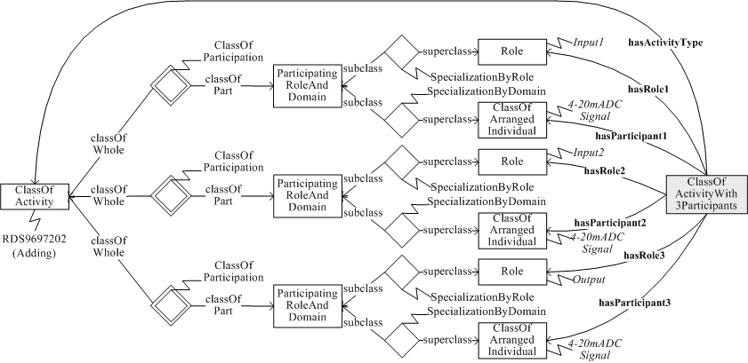
Hans Example 1

Slide 6
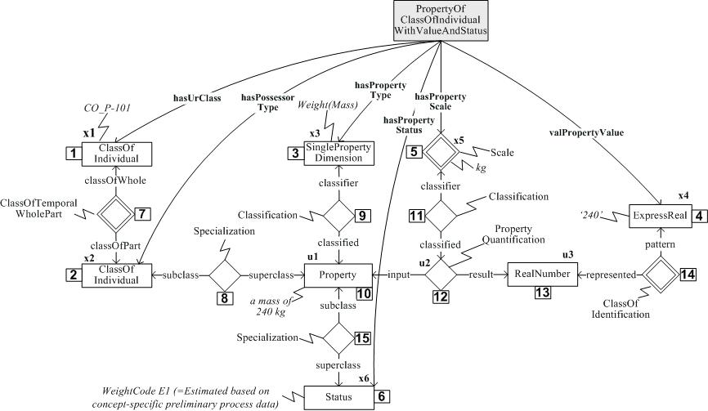
Hans Example 2

